Slide 1
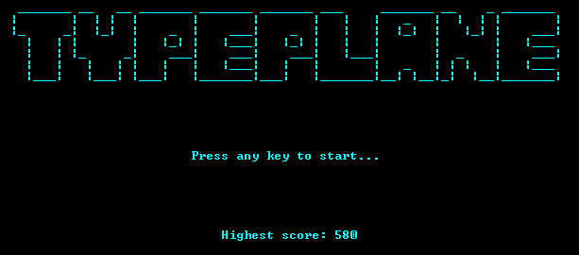
Typeplane
A Typing Game

Slide 2
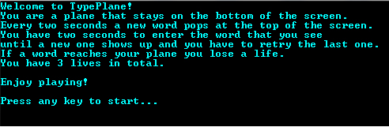
Short Description
We bring to you the stumbling TypePlane game that actually is space shooting kind
of game where words appear from top
falling down and you have to
type them all with speed
and accuracy.

Slide 3
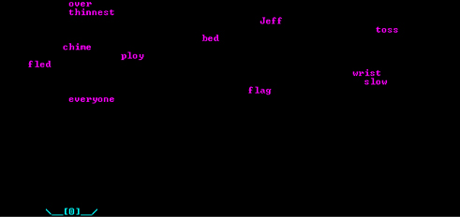
InGame Screenshots
Type as fast as you can!
A lot of words are in front of you!
Don’t let them reach your plane!

Slide 4
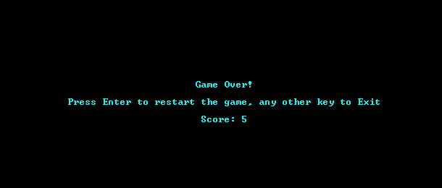
InGame Screenshots
The game is over when
you run out of lives!

Slide 5

Developed By:
Team O.M.A.C.
Ивайло Христов / pl0xicity /
Наталия Драгомирова / Natalia.Dragomirova /
Димитър Чаушев / D.Chaushev /
Иван Марков / Ob1To /
Ясен Стоянов / yasen.stoqnov /
Георгис Андонис / LovechGuy /

